Slide 1
December 15, 2020
Dr. Yuriy Matsiyevsky
Questioning Authoritarian Congruence:
Why Authoritarianism has weak chances in Ukraine

Slide 2
Global background and Ukrainian context
The global rise of populism
Backsliding of democracy in East Central Europe
Ukraine’s post Euromaidan turbulence (unfinished war, slow reforms and concentration of power in the hands of V. Zelensky)
Ukrainians’ support for an idea of a strong leader

Slide 3
Theoretical background
The congruence thesis – a central assumption of political culture theory. Congruence means similarity, agreement or harmony
“Every nation gets the government it deserves” Joseph de Maistre
The idea of congruence has evolved from the “fit” between political culture and political structure in Almond and Verba (1966) to similarities between authority patterns of various social units in Eckstein (1966, 1977) to the match between elites supply of democracy and masses demand of it in Inglehart and Welzel (2005)
According to the modified formulation, a regime is stable in so far as its authority pattern – the way it governs meets people’s authority beliefs – the way that political authority ought to govern.

Slide 4
Mass beliefs and legitimacy of regimes
Mass beliefs are instrumental in legitimizing all types of regimes
Democratic regimes are stable when people believe that the government is accountable and subject to horizontal checks
Authoritarian regimes are stable when people believe in the legitimacy of dictatorial power

Slide 5
Research objectives and argument
The political culture theory was more concerned with the stability of democratic regimes
It is less pronounced in the studies on autocratization, and barely visible in the field of hybrid regimes.
This research seeks to extend the congruence argument to hybrid regimes by focusing on the case of Ukraine.
In particular, I argue that mixed authority beliefs are largely congruent with hybrid authority pattern, and resulting “hybrid congruence” alongside three groups of societal factors limits the prospect for authoritarianism in Ukraine.

Slide 6
Ukraine as a case of a hybrid regime
Hybrid regime is the mixed one, having some democratic and some authoritarian elements
In Ukraine the competitive elections are often compromised by the range of informal institutions (e.g. clientelism, corruption, and secretive deals among the elites)
Though ineffective these institutions are preferred by the elites as they allow to extract rent even in times of war
Embedded or institutionalized hybridity has become a factor of the regime’s authority pattern

Slide 7
Elites authority pattern and people’s authority beliefs
Elites authority pattern is neither democratic nor authoritarian. It is primed for quick enrichment and avoiding responsibility after removal from power
The people’s authority beliefs are also mixed, that is containing some democratic, but also some authoritarian attitudes
Such a combination of formal and informal institutions and the mixed authority beliefs make Ukraine quite resistant to the changes in both democratic and authoritarian directions

Slide 8
Authoritarianism – a two dimensional concept
Popular perception - strong and unaccountable power of a single or collective ruler
What is behind is the social conditions supportive for authoritarianism (Au.)
AU. is a social syndrome, where submission to authority is underpinned by the people’s ‘mentality’, a leader's charisma or the state’s coercive apparatus
In order to rule with discretion, there are should be (a) an institutionalized monopoly on power, and (b) some minimal degree of public consent, so the ‘unity’ between the leader and the people is attained

Slide 9
(Mis)Interpreting the Empirical Data
The support for a strong leader has been on the rise in various parts of the globe
In Ukraine the request for a strong leader has been growing steadily (from some 40% in the late 90s to 71% in 2010/2014) (Source: WVS. Wave 6).
This trend is often interpreted as the symptom of authoritarian attitudes and support for authoritarian rule
Such interpretation is misleading: the support of the idea of a strong leader is not the same as support for an actual strongman in power, or incumbent. Only the latter can be interpreted as a truly authoritarian attitude
Second: authoritarian attitudes reflect beliefs that are measured using the right-wing and the left-wing authoritarianism scale (RWA/LWA)

Slide 10
RWA/LWA components
RWA: a high degree of submission to the established authorities, high levels of aggression in the name of their authorities, and a high level of conventionalism (Bob Altemeyer. 2006. The Authoritarians. Winnipeg: University of Manitoba)
LWA : dogmatism, punitive attitudes toward dissenters, and a desire for strong leadership. The latter is just one, out of six other components. It cannot be interpreted as a sole indicator of authoritarian attitude.
To prove robust, there should be a strong correlation between the composite RWA/LWA indexes and the support for an authoritarian leader or a party.
In Ukraine these attitudes were not measured on RWA/LWA scale

Slide 11
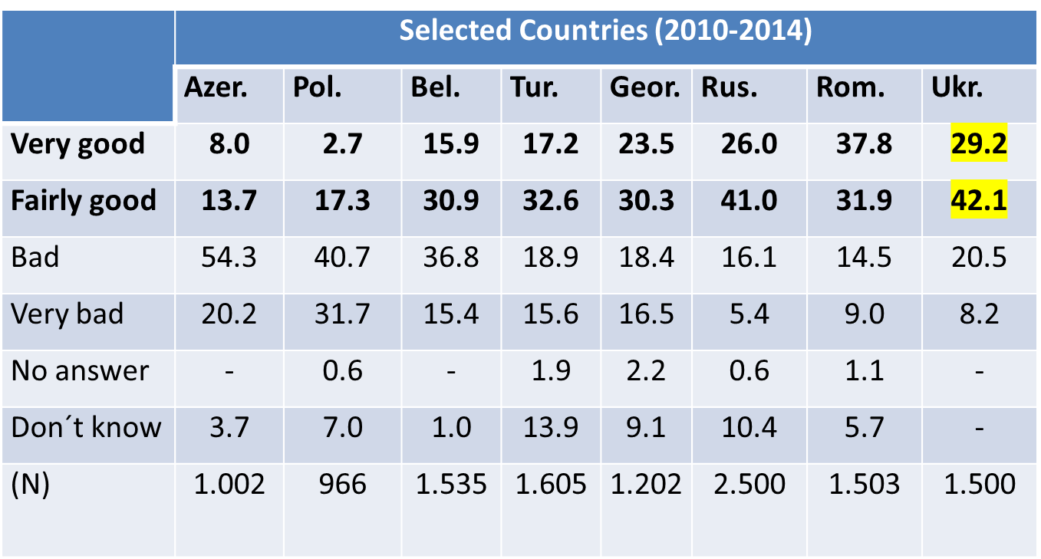
Responses (in percent) to the question: “Having a strong leader, who does not have to bother with parliament and elections” (Source WVS, wave 6)

Slide 12
What do you mean by the strong hand (leader)?
In 2009 survey 62 percent agreed that a leader must act exclusively in compliance with the law, while 15 said – ‘in case of necessity a leader may limit the rights and freedoms for the sake of order’
In 2013 the first option was supported by 82 percent, while the second one - by less than 9 percent of respondents (Source EWVS).

Slide 13
Paternalistic rather than authoritarian attitude
The request for a strong leader reveal the lack of social justice, social protection, and the rule of law
Overall a desire for a strong leader in Ukraine is clearly related to pervasive corruption, economic insecurity, but also weak self-efficacy
Hence is the belief and the expectation that it is not me, but someone else (a strong leader) who could come and solve my problems
In 2019 survey 73 percent of respondents agreed that state should control the economy as well as individual freedoms (Vox Ukraine, 2019)

Slide 14
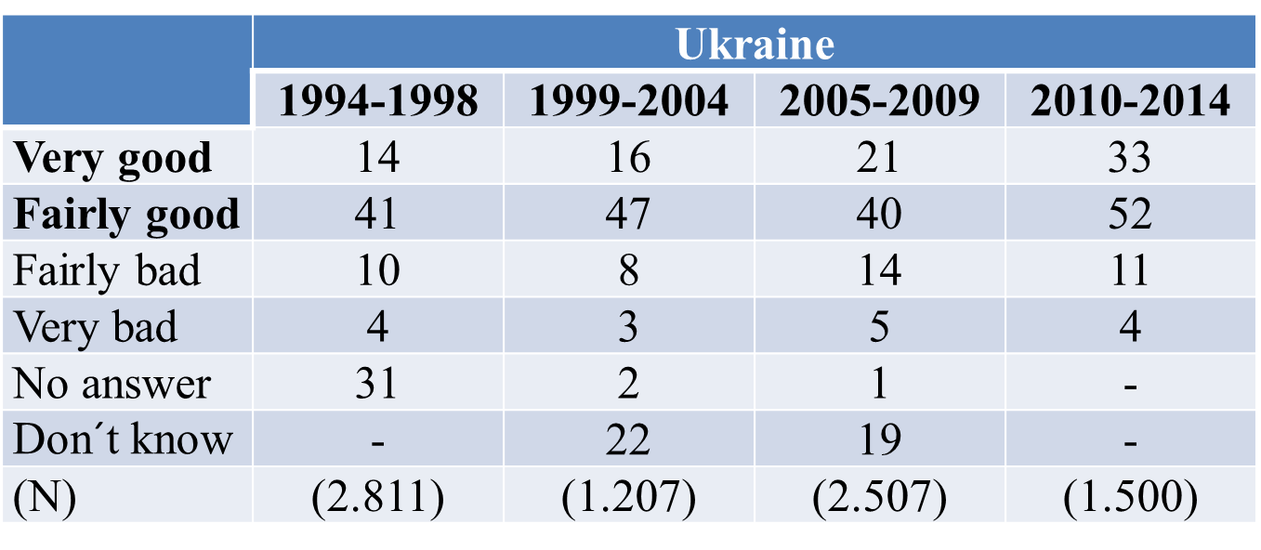
Responses (in percent) to the question: “Having a democratic political system” (Source WVS)

Slide 15
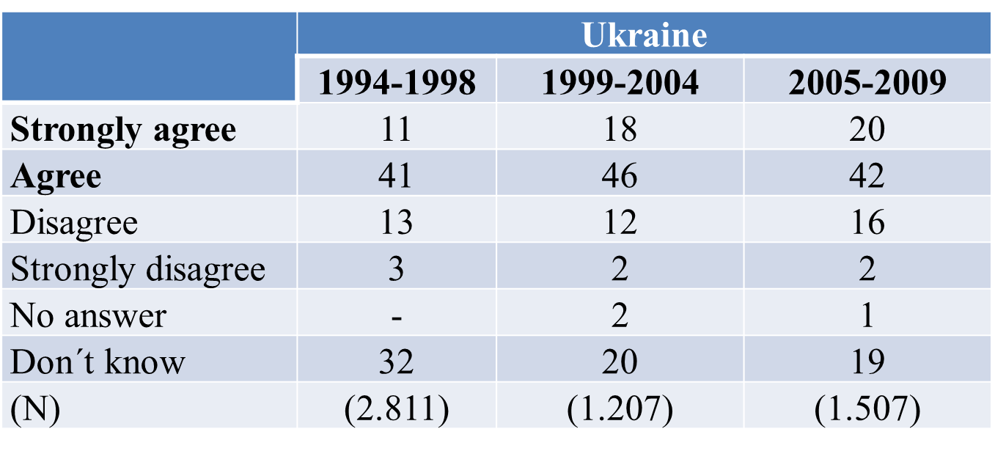
Democracy may have problems but is better (Source WVS)

Slide 16
“Having a democratic political system” (source WVS, 2011)
 | The region where the interview was conducted
 | Western | Eastern | Central | Southern
Very good | 37.8 | 29.2 | 31.8 | 34.6
Fairly good | 52.7 | 50.1 | 52.8 | 51.8
Fairly bad | 6.8 | 15.7 | 10.0 | 10.7
Very bad | 2.7 | 5.0 | 5.5 | 2.9
(N) | (353) | (314) | (440) | (393)

Slide 17
Mixed authority beliefs
Ukrainians, like many other post-communist nations, perceive democracy as compatible with the idea of a strong leader
It is an example of how paternalistic attitudes produce delegative understanding of democracy in hybrid regimes
Delegative democracy is a term used to describe newly established democracies where a president or prime-minister has a free rein to act and justify his or her acts in the name of the people.
It is an opposite to representative democracy, where government is accountable to the people

Slide 18
Liberal versus Authoritarian notions of democracy in Ukraine
An opposite pattern – the support of democracy in non-democratic regimes
People express their support for democracy, but reverse its meaning.
To resolve this paradox Helen Kirsch and Christian Welzel (2018) suggested to differentiate between liberal and authoritarian notions of democracy.
LND score is twice higher than that of AND (0.82 to 0.41 respectively) while emancipative values score is positive and growing from 0.38 in the 5th wave to 0.40 in the 6th wave (on the scale from – 1.60 to +2.80)
This figures signify that Ukrainians (a) share mixed – liberal and authoritarian notions of democracy, but (b) the former prevail and is supported by the positive score of emancipative values.
This suggests that the prevalence of democratic beliefs would press the regime to increase, but not to limit the supply of democracy

Slide 19
Factors preventing the emergence of authoritarianism in Ukraine
Structural: poor leadership legitimacy, poor economy performance, regional polarization, weak state repressive capacity, the relative weakness of the ‘party of power’, fragmented elite structure, the growing linkage with the West.
Institutional: semi-presidentialism, institutionalized hybridity (the legacy of being hybrid regime).
Sociocultural: lack of charismatic leadership and unifying ideology, mixed public attitudes and gravity of three (1990, 2004, 2014) waves of anti-authoritarian protest.

Slide 20
Conclusions
Authoritarian congruence is hardly achievable in post-Euromaidan Ukraine
Mixed, but largely democratic public attitudes prevent Ukraine from moving in authoritarian directions.
It does not mean that authoritarian populist cannot be voted for power in Ukraine.
There at least three groups of societal factors that prevent him/her from consolidating power and establish some sort of authoritarian rule.
Under given constraints this will likely lead not to democratization or autocratization, but deepening the hybridity of Ukraine’s regime

Slide 21
Selected bibliography
Almond, G., Verba, S. (1963). The Civic Culture: Political Attitudes and Democracy in Five Nations. Princeton: Princeton University Press.
Altemeyer, B. (2006). The Authoritarians. Winnipeg: University of Manitoba.
Eckstein, H. (1966). A Theory of Stable Democracy. Princeton, NJ: Princeton University Press.
Eckstein, H. (1977). Congruence Theory Explained. UC Irvine: Center for the Study of Democracy, Retrieved from: https://escholarship.org/uc/item/2wb616g6
Eckstein, H.(1991). Regarding Politics: Essays on Political Theory, Stability, and Change. Berkeley: University of California Press
Kirsch, H., Welzel, Ch. (2018). Democracy Misunderstood: Authoritarian Notions of Democracy Around the Globe. Social Forces, 97,1–33. https://doi.org/10.1093/sf/soy114
Levitsky, S., Way, L. A. (2010). Competitive Authoritarianism: Hybrid Regimes after the Cold War. Problems of International Politics. Cambridge: Cambridge University Press.
Linz, J. (1975). Totalitarian and Authoritarian Regimes. In: Greenstein F. I., et. al. (eds.), Handbook of Political Science, Vol. 3: Macro-Political Theory, Reading, Mass: Addison-Wesley.
Matsiyevsky, Y. (2018). Ukraine’s Regime Is Less Stable than It Was under Yanukovych: A Third Year Comparison”. PONARS Eurasia policy memo # 517, Retrieved from http://www.ponarseurasia.org/memo/ukraine-regime-less-stable-than-under-yanukovych-third-year-comparison
Matsiyevsky, Y. (2018). Western Leverage, Russia’s Resistance and the Breakdown of the Yanukovych Regime. In: G. Soroka and T. Stepniewski (Еds.) Ukraine after Maidan. Revisiting Domestic and Regional Security. (pp.157-159). Ibidem.
Matsiyevsky, Y. (2018). Revolution without Regime Change: The Evidence from the Post-Euromaidan Ukraine. Communist and Post-Communist Studies, 51(4), 349–359. https://doi.org/10.1016/j.postcomstud.2018.11.001
Way, L. (2015). Pluralism by Default: Weak Autocrats and the Rise of Competitive Politics. Baltimore: Johns Hopkins University Press.

Slide 22
Selected bibliography
Welzel, Ch. (2013). Freedom Rising. Online Appendix. Retrieved from https://www.cambridge.org/de/files/8613/8054/8416/FreedomRising_OA.pdf
Welzel, Ch., Inglehart R., (2009). Political Culture, Mass beliefs, and Value Change. In: Ch. Haerpfer, P. Bernhagen, R.F. Inglehart, Ch.Welzel, (Eds.), Democratization. Oxford: Oxford University Press.
Мациевский, Ю. (2018). В ловушке гибридности: политический режим в Украине после революции 2014 года. Полис. Политические исследования,1, 96–115. https://doi.org/10.17976/jpps/2018.01.07
Мацієвський, Ю. (2016). У пастці гібридності: зиґзаґи трансформацій політичного режиму в Україні (1991-2014). Чернівці: Книги – XXI.
Мацієвський, Ю. (2010). Який режим будує В. Янукович і що з цього вийде? Наукові записки Національного університету «Острозька академія». Серія «Політичні науки», 4, 274–289.
Мацієвський, Ю. (2020). Змішані цінності і суспільні обмеження: чому запит на «сильну руку» не призведе до авторитаризму в Україні. Соціологія: теорія, методи, маркетинг, 4, 43–67. DOI 10.15407/sociology2020.04.043
Мацієвський, Ю. (2020). Від партій-субститутів до справжніх партій: чи можливо це в Україні? Політичні партії і вибори: українські та світові практики: Зб. ст. і тез за результатами IV міжнародної наукової конференції “Політичні партії і вибори: українські та світові практики”. А. Романюк і В. Литвин (ред.). (Вип. 4, сс. 282–286). Львів: Львівський національний університет імені Івана Франка.
Мацієвський, Ю. (2011). Інволюція конституціоналізму і квазі-авторитарний режим в Україні. Вибори і демократія, Вип. 3, 49–56.
Мацієвський, Ю. (2011). Спокуси авторитаризмом. Критика, 5-6, 2–7.
Резнік, О. (2017). Декларативна авторитарність масової свідомості українців: реальні та фіктивні загрози демократії. Агора, 19-20, 26–31.

